Slide 1
A Brief Introduction to
Hadoop and Spark
Chun-Wei Tsai
TA: Yi-Chung Wang, Ze-Hong Chen, and Shi-Rui Liu
Computer Science and Engineering
National Sun Yat-sen University
Notes:
1

Slide 2
Before We Begin
Goal of this presentation
Understand how to install Hadoop [1] and Spark [2] on your computer
A data clustering algorithm k-means for Hadoop [3]
You can download the instructions and source code from my personal web site
Notes:
2

Slide 3
Cloud computing
Hadoop Spark
Advance Research Conclusion Remarks
Notes:
3

Slide 4
Why do we need cloud computing?
The basic idea of distributed computing
centralized vs. decentralized
From cluster computing, grid computing to cloud computing
cost 1 10 500
cost 1 4+0.5 16+2
Notes:
4

Slide 5
Cloud computing
Hadoop Spark
Advance Research Conclusion Remarks
Notes:
5

Slide 6
Hadoop Installation (1/14)
References
https://sites.google.com/site/cwtsai0807/home/cloud-computing
http://hadoopspark.blogspot.tw/
Environment
Linux, e.g., fedora
ThinkPad X240s Notebook, Intel i7-4500U/8GB RAM
Notes:
6

Slide 7
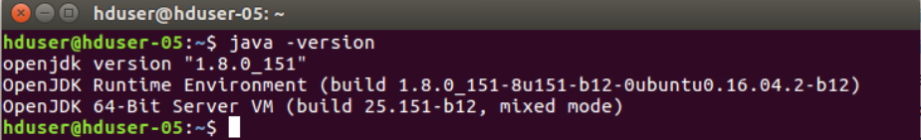
Hadoop Installation (2/14)
Step 1. Install the JDK
$ sudo apt-get install default-jdk
or
sudo apt-get install openjdk-8-jdk
Step 2. Check your Java Environment
$ java -version
$ update-alternatives --display java
/usr/lib/jvm/java-8-openjdk-amd64
Notes:
7

Slide 8
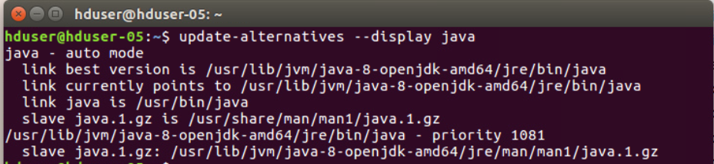
Hadoop Installation (3/14)
Notes:
8

Slide 9
Hadoop Installation (4/14)
Step 3. SSH login without password
$ sudo apt-get install ssh
$ ssh-keygen -t rsa
$ cd ~/.ssh/
$ cp id_rsa.pub authorized_keys
$ ssh localhost
$ exit
Notes:
9

Slide 10
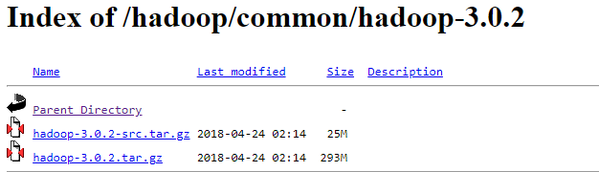
Hadoop Installation (5/14)
Step 4. Download the Hadoop
http://apache.stu.edu.tw/hadoop/common/hadoop-3.0.2/hadoop-3.0.2.tar.gz
Select the version you want
$ wget http://apache.stu.edu.tw/hadoop/common/hadoop-3.0.2/hadoop-3.0.2.tar.gz
$ sudo tar -zxvf hadoop-3.0.2.tar.gz
$ sudo mv hadoop-3.0.2 /usr/local/hadoop
$ cd /usr/local/hadoop/etc/hadoop/
Notes:
10

Slide 11
Hadoop Installation (6/14)
Step 5. Hadoop configuration 1
$ sudo gedit ~/.bashrc
export JAVA_HOME=/usr/lib/jvm/java-8-openjdk-amd64
export HADOOP_HOME=/usr/local/hadoop
export PATH=$PATH:$HADOOP_HOME/bin
export PATH=$PATH:$HADOOP_HOME/sbin
export HADOOP_MAPRED_HOME=$HADOOP_HOME
export HADOOP_COMMON_HOME=$HADOOP_HOME
export HADOOP_HDFS_HOME=$HADOOP_HOME
export YARN_HOME=$HADOOP_HOME
export HADOOP_COMMON_LIB_NATIVE_DIR=$HADOOP_HOME/lib/native
export HADOOP_OPTS="-Djava.library.path=$HADOOP_HOME/lib/native"
export JAVA_LIBRARY_PATH=$HADOOP_HOME/lib/native:$JAVA_LIBRARY_PATH
$ source ~/.bashrc
Notes:
11

Slide 12
Hadoop Installation (7/14)
Step 7. Hadoop configuration 2
$ sudo gedit hadoop-env.sh
export JAVA_HOME=/usr/lib/jvm/java-8-openjdk-amd64
export HADOOP_CLASSPATH=/usr/lib/jvm/java-8-openjdk-amd64/lib/tools.jar
Notes:
12

Slide 13
Hadoop Installation (8/14)
Step 6. Hadoop configuration 3
$ sudo gedit core-site.xml
<configuration>
<property>
<name>fs.default.name</name>
<value>hdfs://localhost:9000</value>
</property>
</configuration>
Notes:
13

Slide 14
Hadoop Installation (9/14)
Step 7. Hadoop configuration 4
$ sudo gedit hdfs-site.xml
<configuration>
<property>
<name>dfs.replication</name>
<value>3</value>
</property>
<property>
<name>dfs.namenode.name.dir</name>
<value>file:/usr/local/hadoop/hadoop_data/hdfs/namenode</value>
</property>
<property>
<name>dfs.datanode.data.dir</name>
<value>file:/usr/local/hadoop/hadoop_data/hdfs/datanode</value>
</property>
</configuration>
Notes:
14

Slide 15
Hadoop Installation (10/14)
Step 8. Hadoop configuration 5
$ sudo gedit mapred-site.xml
<configuration>
<property>
<name>mapreduce.application.classpath</name> <value>$HADOOP_MAPRED_HOME/share/hadoop/mapreduce/*,$HADOOP_MAPRED_HOME/share/hadoop/mapreduce/lib/*,$HADOOP_MAPRED_HOME/share/hadoop/common/*,$HADOOP_MAPRED_HOME/share/hadoop/common/lib/*,$HADOOP_MAPRED_HOME/share/hadoop/yarn/*,$HADOOP_MAPRED_HOME/share/hadoop/yarn/lib/*,$HADOOP_MAPRED_HOME/share/hadoop/hdfs/*,$HADOOP_MAPRED_HOME/share/hadoop/hdfs/lib/*</value>
</property>
<property>
<name>mapreduce.framework.name</name>
<value>yarn</value>
</property>
</configuration>
Notes:
15

Slide 16
Hadoop Installation (11/14)
Step 9. Hadoop configuration 6
$ sudo gedit yarn-site.xml
<configuration>
<property>
<name>yarn.nodemanager.aux-services</name>
<value>mapreduce_shuffle</value>
</property>
<property>
<name>yarn.nodemanager.env-whitelist</name> <value>JAVA_HOME,HADOOP_COMMON_HOME,HADOOP_HDFS_HOME,HADOOP_CONF_DIR,CLASSPATH_PREPEND_DISTCACHE,HADOOP_YARN_HOME,HADOOP_MAPRED_HOME</value>
</property>
<property>
<name>yarn.nodemanager.aux-services</name>
<value>mapreduce_shuffle</value>
</property>
<property>
<name>yarn.nodemanager.aux-services.mapreduce.shuffle.class</name>
<value>org.apache.hadoop.mapred.ShuffleHandler</value>
</property>
</configuration>
Notes:
16

Slide 17
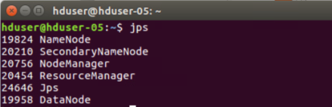
Hadoop Installation (12/14)
Step 10. Format HDFS
$ sudo mkdir -p /usr/local/hadoop/hadoopfs/data
$ sudo mkdir -p /usr/local/hadoop/hadoopfs/name
$ sudo chown hduser:hduser -R /usr/local/hadoop
$ hadoop namenode -format
Step 11. Launch the Hadoop
$ start-all.sh
$ jps
Notes:
17

Slide 18
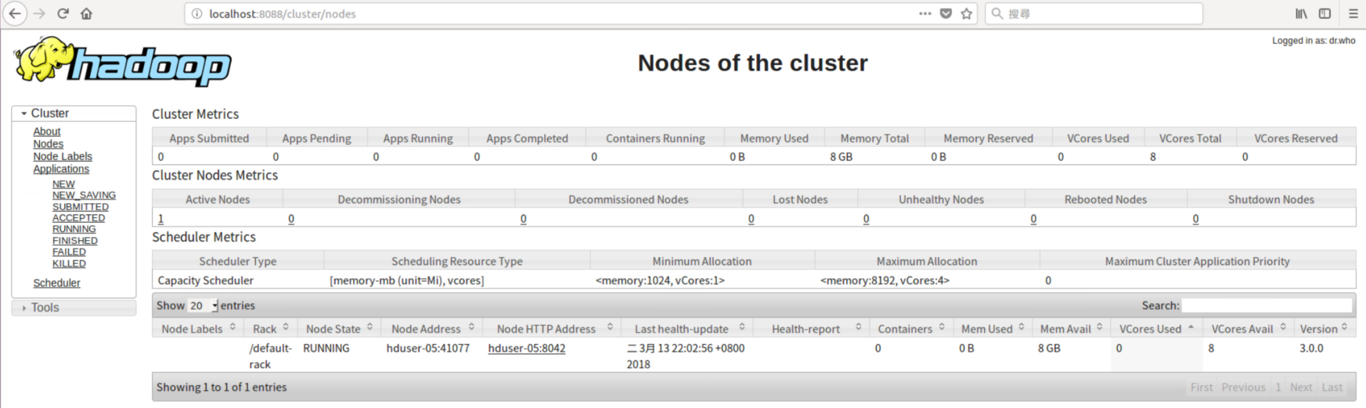
Hadoop Installation (13/14)
Using your browser to connect to
http://localhost:8088
Notes:
18

Slide 19
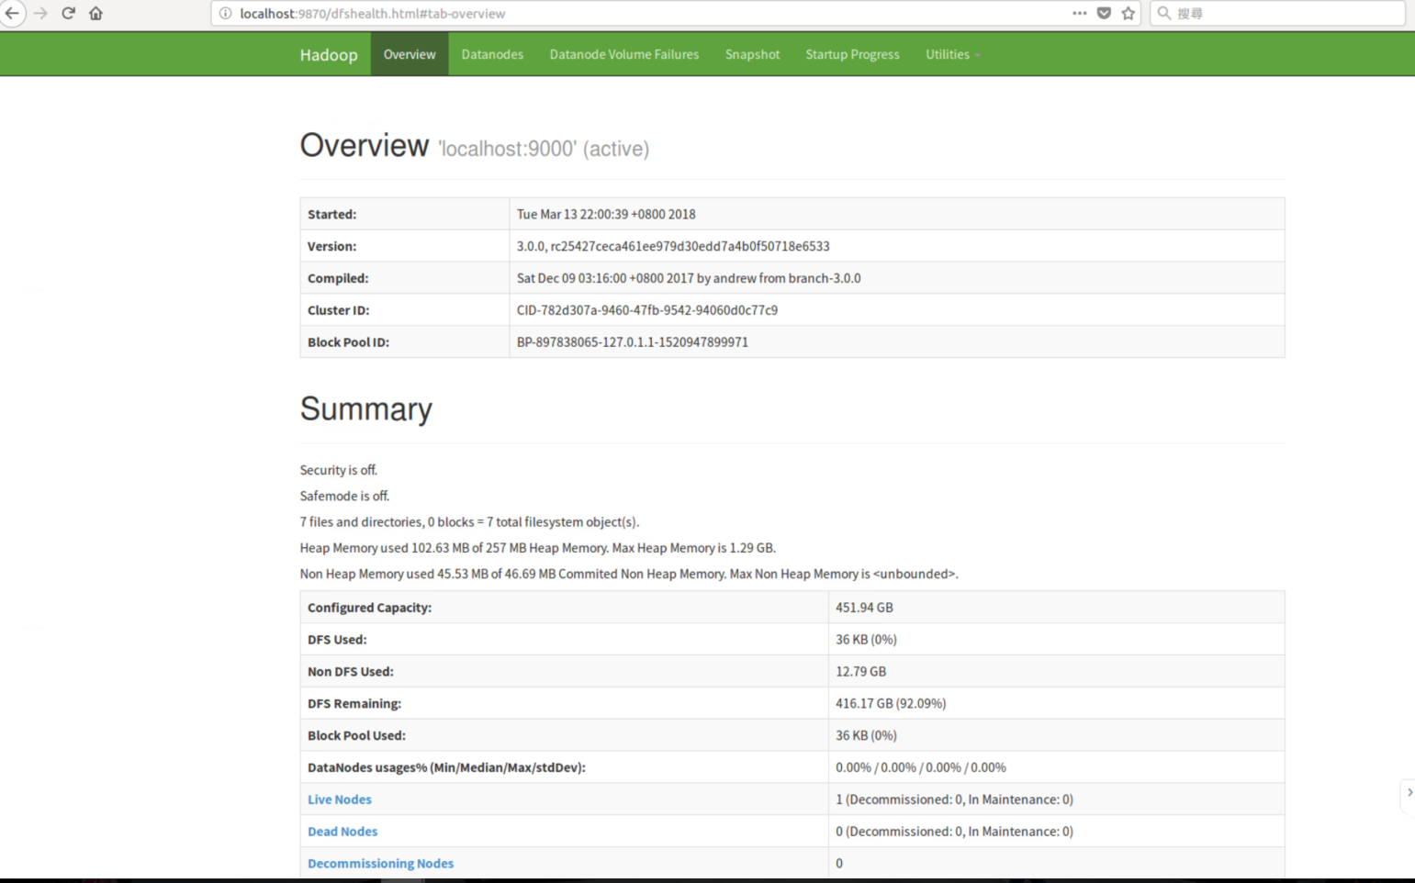
Hadoop Installation (14/14)
Using your browser to connect to
http://localhost:9870/
Notes:
19

Slide 20
Wordcount Program on Hadoop (1/4)
Using the wordcount as an example
Step 1. copy a text file to HDFS
$ hadoop fs -mkdir /input
$ hadoop fs -mkdir /input/test
$ hadoop fs -copyFromLocal LICENSE.txt /input/test
$ hadoop fs -ls /input/test
Notes:
20

Slide 21
Wordcount Program on Hadoop (2/4)
Step 2. Download the source code of wordcount from
http://hadoop.apache.org/docs/current/hadoop-mapreduce-client/hadoop-mapreduce-client-core/MapReduceTutorial.html
Step 3. Compile and run wordcount.java
$ hadoop com.sun.tools.javac.Main WordCount.java
$ jar cf wc.jar WordCount*.class
$ hadoop jar wc.jar WordCount /input/test/LICENSE.txt /output
$ hadoop fs -cat /output/part-r-00000
Notes:
21

Slide 22
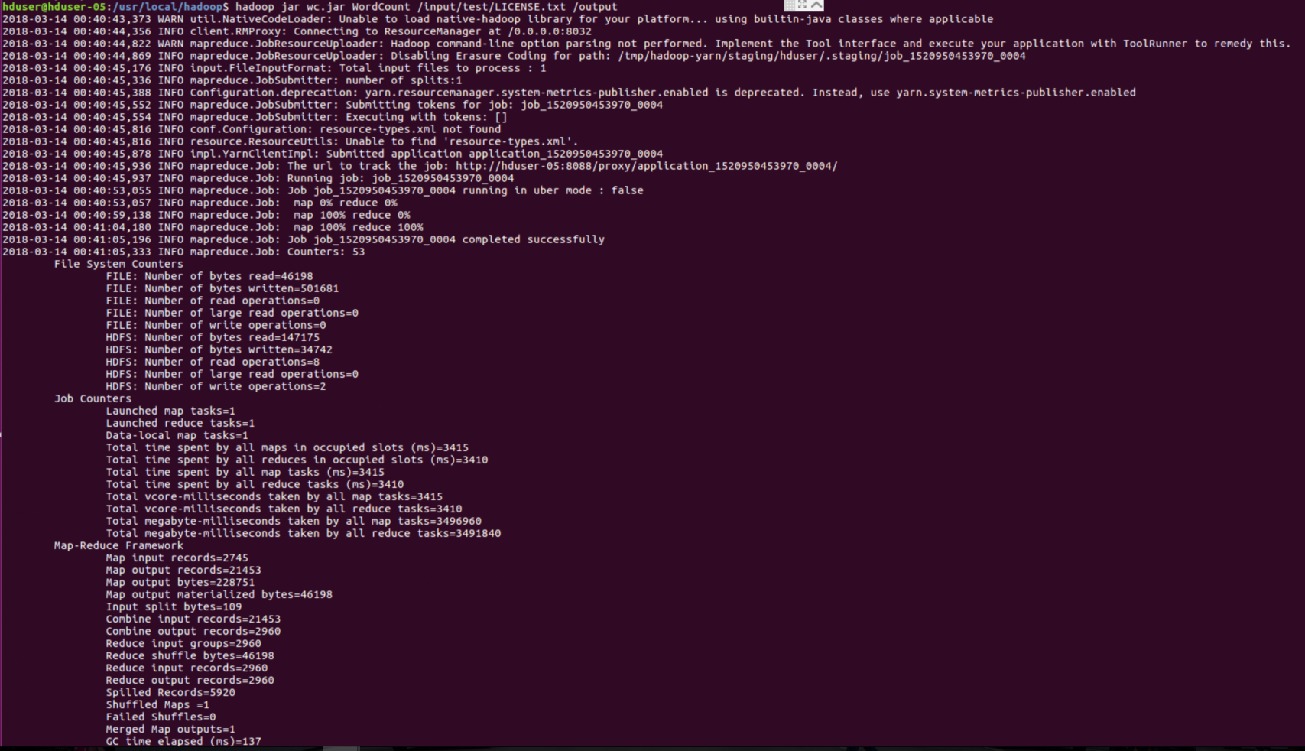
Wordcount Program on Hadoop (3/4)
The results of Wordcount for “LICENSE.txt”
Notes:
22

Slide 23
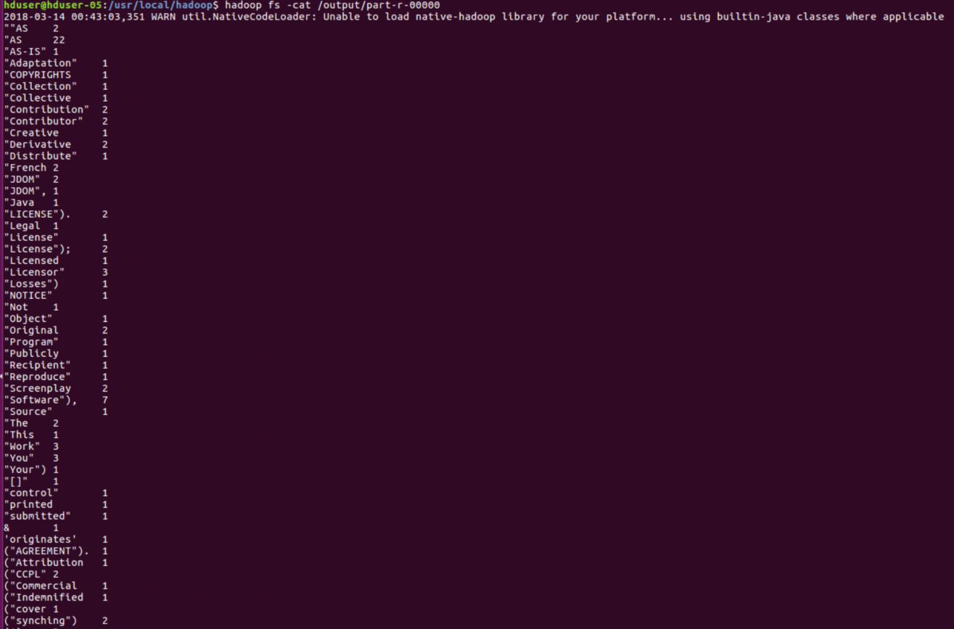
Wordcount Program on Hadoop (4/4)
Notes:
23

Slide 24
Cloud computing
Hadoop Spark
Advance Research Conclusion Remarks
Notes:
24

Slide 25
Why Spark?
Spark can be 100x faster than Hadoop for large scale data processing, by exploiting in-memory computing and other optimizations [1].
Spark requires a lot of memory. Much like standard DBs, it loads a process into memory and keeps it there until further notice, for the sake of caching [2].
[1] https://databricks.com/spark/about
[2] https://www.xplenty.com/blog/2014/11/apache-spark-vs-hadoop-mapreduce/
Notes:
25

Slide 26
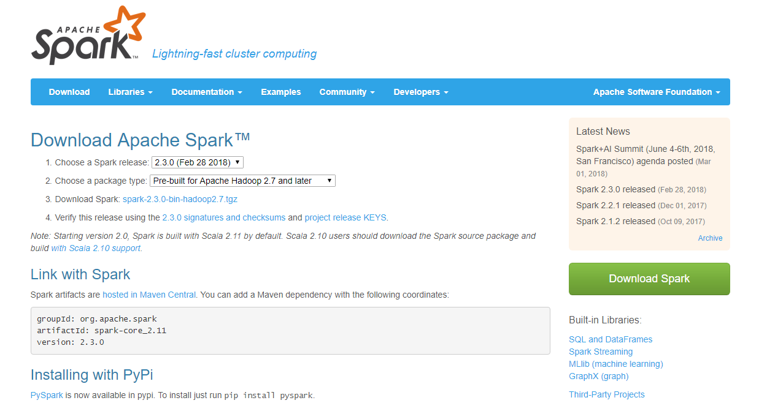
Spark Installation (1/3)
Step 1. Download Spark from http://spark.apache.org/downloads.html
Step 2. Uncompress Spark files
$ tar -xzvf spark-2.3.1-bin-hadoop2.7.tgz
$ sudo mv spark-2.3.1-bin-hadoop2.7 /usr/local/spark/
Notes:
26

Slide 27
Spark Installation (2/3)
Step 3. Set Spark Home
$ sudo gedit ~/.bashrc
export SPARK_HOME=/usr/local/spark
export PATH=$PATH:$SPARK_HOME/bin
$ source ~/.bashrc
Notes:
27

Slide 28
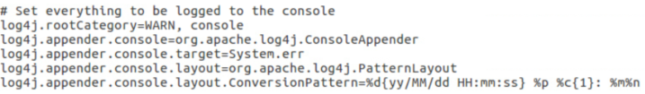
Spark Installation (3/3)
Step 4. Decrease the info message of Spark
$ cd /usr/local/spark/conf
$ cp log4j.properties.template log4j.properties
$ sudo gedit log4j.properties
INFO change to WARN
Notes:
28

Slide 29
Wordcount Program on Spark (1/9)
Go to the home directory (/usr/local/spark) of Spark and then do the following:
$ cd $SPARK_HOME/examples/src/main/python
$ spark-submit wordcount.py 123.txt
(Ubuntu18.04版本內為python3需手動指定python3 執行以下指令)
sudo gedit /usr/local/spark/bin/pyspark 尋找到以下行
PYSPARK_DRIVER_PYTHON="${PYSPARK_PYTHON:-"python”}“
PYSPARK_PYTHON=python
export PYSPARK_PYTHON
(更正為)
PYSPARK_DRIVER_PYTHON="${PYSPARK_PYTHON:-"python3”}“
PYSPARK_PYTHON=python3
export PYSPARK_PYTHON=python3
(若要安裝python2 指令為 sudo apt install python)
Notes:
29

Slide 30
Wordcount Program on Spark (2/9)
$ spark-submit --master local[4] --driver-memory 2g --executor-memory 2g
wordcount.py 123.txt
--master
local[4], Execute the program via four threads running on a single machine
spark://Master:7077, Execute the program via multiple nodes
yarn-cluster, Execute the program via multiple nodes with Hadoop-yarn
--driver-memory and --executor-memory
Allocate the computing resource for this program
Notes:
30

Slide 31
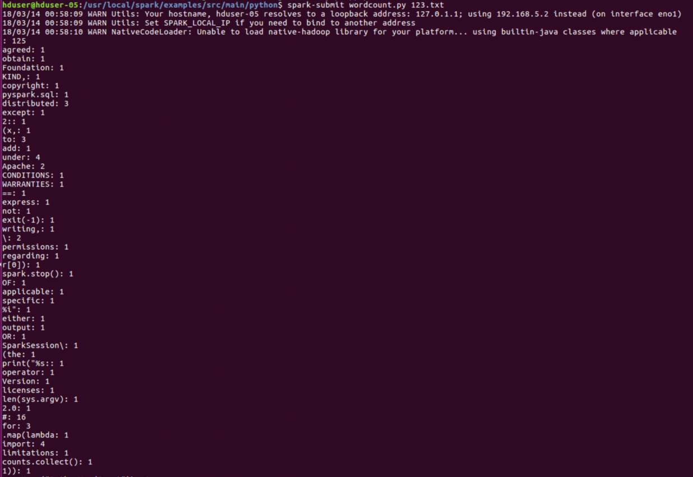
Wordcount Program on Spark (3/9)
The results of wordcount
Notes:
31

Slide 32
Hadoop Multi Node Cluster
以下為JAVA版Spark
Notes:
32

Slide 33
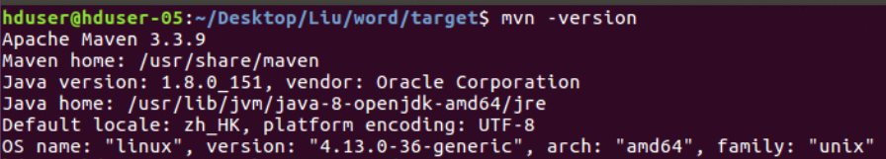
Wordcount Program on Spark (4/9)
Install maven.
$ apt-cache search maven
$ sudo apt-get install maven
$ mvn -version
Install maven in ubuntu:
https://maven.apache.org/guides/getting-started/maven-in-five-minutes.html
Notes:
33

Slide 34
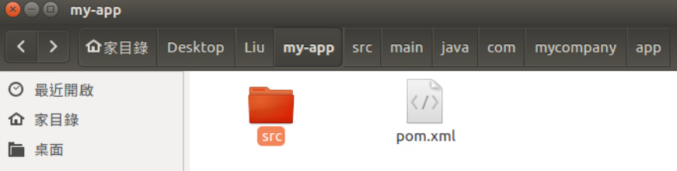
Wordcount Program on Spark (5/9)
Generate maven example.
mvn archetype:generate
-DgroupId=Artifact Group
-DartifactId=Artifact ID
-DarchetypeArtifactId=maven-archetype-quickstart
-DinteractiveMode=false
E.g.
$ mvn archetype:generate -DgroupId=com.mycompany.app -DartifactId=my-app -DarchetypeArtifactId=maven-archetype-quickstart -DinteractiveMode=false
Maven Reference:
https://maven.apache.org/guides/getting-started/maven-in-five-minutes.html
https://maven.apache.org/guides/MavenQuickReferenceCard.pdf
Notes:
34

Slide 35
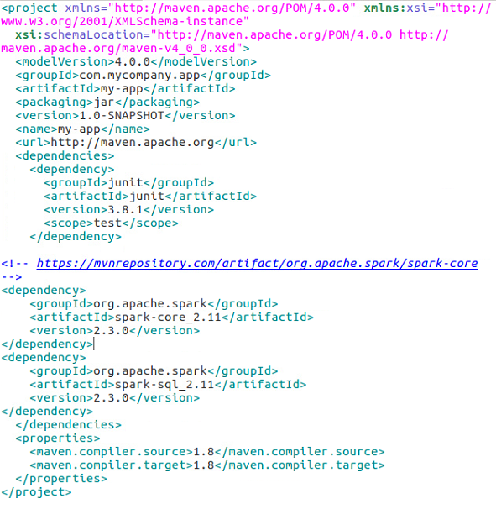
Wordcount Program on Spark (6/9)
Add spark compiler to pom.xml
$ cd my-app
$ sudo gedit pom.xml
<dependency>
<groupId>org.apache.spark</groupId>
<artifactId>spark-core_2.11</artifactId>
<version>2.3.0</version>
</dependency>
<dependency>
<groupId>org.apache.spark</groupId>
<artifactId>spark-sql_2.11</artifactId>
<version>2.3.0</version>
</dependency>
Maven repository spark project core:
https://mvnrepository.com/artifact/org.apache.spark/spark-core
https://mvnrepository.com/artifact/org.apache.spark/spark-sql_2.11
Notes:
35

Slide 36
Wordcount Program on Spark (7/9)
Word count code
$ gedit src/main/java/com/mycompany/app/App.java
Paste the word count code from
/usr/local/spark/examples/src/main/java/org/apache/spark/examples/JavaWordCount.java
Notes:
36

Slide 37
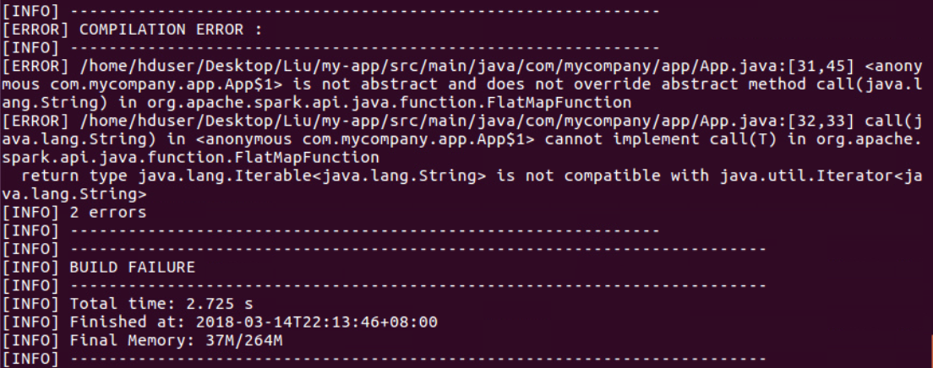
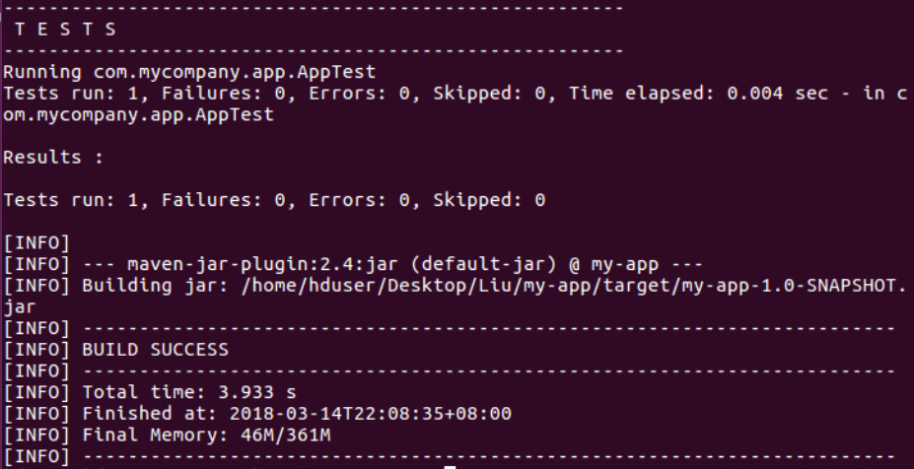
Wordcount Program on Spark (8/9)
Compile
$ mvn package
Failure Success
Notes:
37

Slide 38
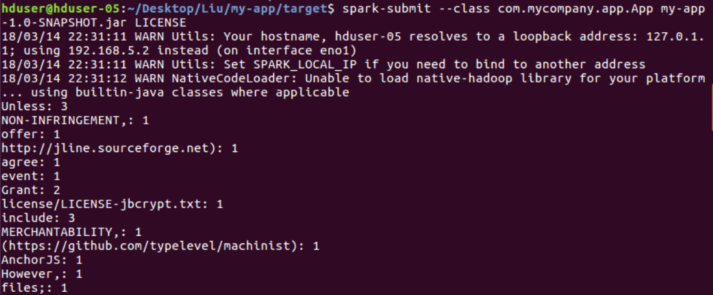
Wordcount Program on Spark (9/9)
Execute the jar
$ cd target
$ spark-submit --class com.mycompany.app.App my-app-1.0-
SNAPSHOT.jar input.txt
“input.txt” is the text you want to count.
Notes:
38

Slide 39
Cloud computing
Hadoop Spark
Advance Research Conclusion Remarks
Notes:
39

Slide 40
The basic idea of data clustering
Partition n patterns into k groups or clusters based on some similarity metric.
image1
codebook
image2
k-means
Vector Quantization
Notes:
40

Slide 41
The basic idea of k-means
Partition n patterns into k groups or clusters based on some similarity metric.
Step 1. Partition n patterns into k nonempty groups randomly
Step 2. Update the means (i.e., the centroid of each cluster)
Step 3. Assign each object to the nearest cluster (i.e., the cluster the centroid of which is closest to the object)
Step 4. When the assignment does not change, output the current
results; otherwise, go back to Step 2,
Notes:
41

Slide 42
MapReduce version of k-means
How to use it
$ hadoop fs -rm -R $1
$ hadoop com.sun.tools.javac.Main $2.java
$ jar cf $2.jar $2*.class
$ hadoop jar $2.jar $2 $3 $4 $5 $6 $7
An example to use this script
$./km.sh /kmeans KMeansForIris /input/test/iris.data /kmeans 3 4 0.1\n
Notes:
42

Slide 43
Cloud computing
Hadoop Spark
Advance Research Conclusion Remarks
Notes:
43

Slide 44
Conclusion Remarks (1/3)
Cloud computing
From multi-threads programming to MapReduce programming
From Hadoop to Spark
Notes:
44

Slide 45
Conclusion Remarks (2/3)
Please see also
Chun-Wei Tsai, Wei-Cheng Huang, Meng-Hsiu Chiang, Ming-Chao Chiang, and Chu-Sing Yang,
“A Hyper-Heuristic Scheduling Algorithm for Cloud,"
IEEE Transactions on Cloud Computing, vol. 2, no. 2, pp. 236-250, 2014.
Chun-Wei Tsai, Cheng-Han Hsieh, and Ming-Chao Chiang,
“Parallel Black Hole Clustering Based on MapReduce,”
IEEE International Conference on Systems, Man and Cybernetics, 2015.
Chun-Wei Tsai, Heng-Ci Chang, Kai-Cheng Hu, and Ming-Chao Chiang,
“Parallel Coral Reef Algorithm for Solving JSP on Spark,”
IEEE International Conference on Systems, Man, and Cybernetics, 2016.
Notes:
45

Slide 46
Conclusion Remarks (3/3)
When do we need to use cloud computing?
Does it solve the whole problem?
Advance Research Topics
Big Data Analytics System
Large-scale and complex optimization problem
Internet of Things data analysis
Notes:
46

Slide 47

Thank You ;-)
Notes:
47

